Slide 1
PokeDex
Peerawit Chariyawongsiri 6238151921

Slide 2

My Goal
Create a mobile application that can search and find detail about each pokemons. In addition, there would be a list to select what type of status does the user want to sort list by..

Slide 3
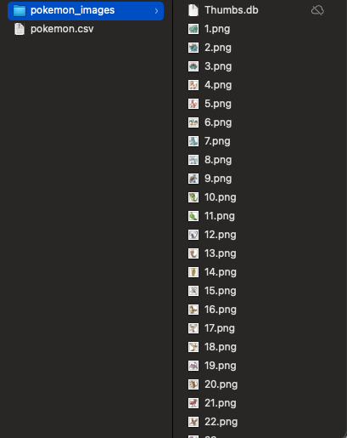
My Dataset
The data I use will be from csv file and image files. Each pokemon will have a picture that represent it, and all pokemon stats will be present to the user.
Ps. Next page will present a part of the dataset.
Link: https://www.kaggle.com/yash1610/pokemon-dataset?select=pokemon_images

Slide 4
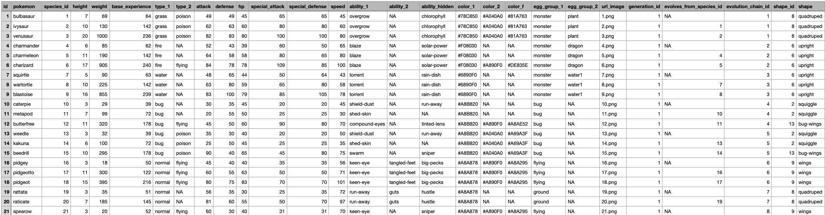
How my data looks like

Slide 5

Data Analysis
I will analyze data by sorting by different variables, and also finding the total amount of favorited pokemon. There will also be a page option to show the count ,max, min and average of your favorited pokemon

Slide 6
UI Design
Link: https://xd.adobe.com/view/adc20470-b0f0-49c0-9c6e-128626740615-f891/
The file of the design is also in the folder.

Slide 7
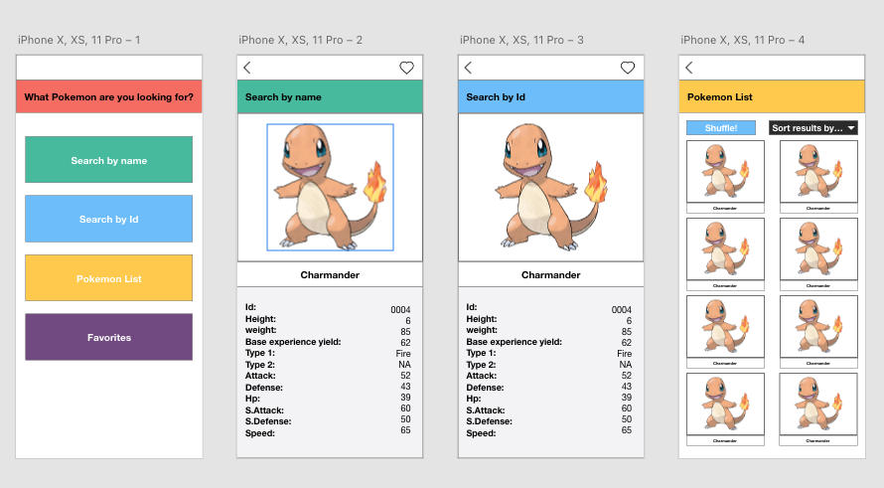

Slide 8
